Slide 1
Loss functions in Deep learning

Slide 2
Loss function
A loss function in deep learning is a mathematical function that quantifies how well a model’s predictions match the actual target values. It measures the error for a single data point by comparing the predicted outcome with the ground truth. The goal of training a model is to minimize this loss, which helps improve the model's accuracy.

Slide 3
Difference between loss function and cost function
Loss function/error function – Error for a single sample
Cost function – Error of the loss over the entire dataset

Slide 4
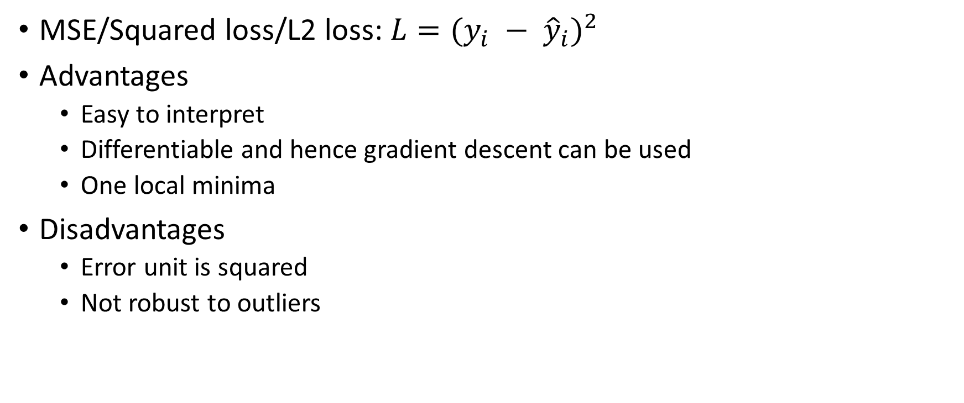
Regression loss functions
MSE/Squared loss/L2 loss: $L=(y_{i} − {\hat{y}}_{i})^{2}$
Advantages
Easy to interpret
Differentiable and hence gradient descent can be used
One local minima
Disadvantages
Error unit is squared
Not robust to outliers

Slide 5
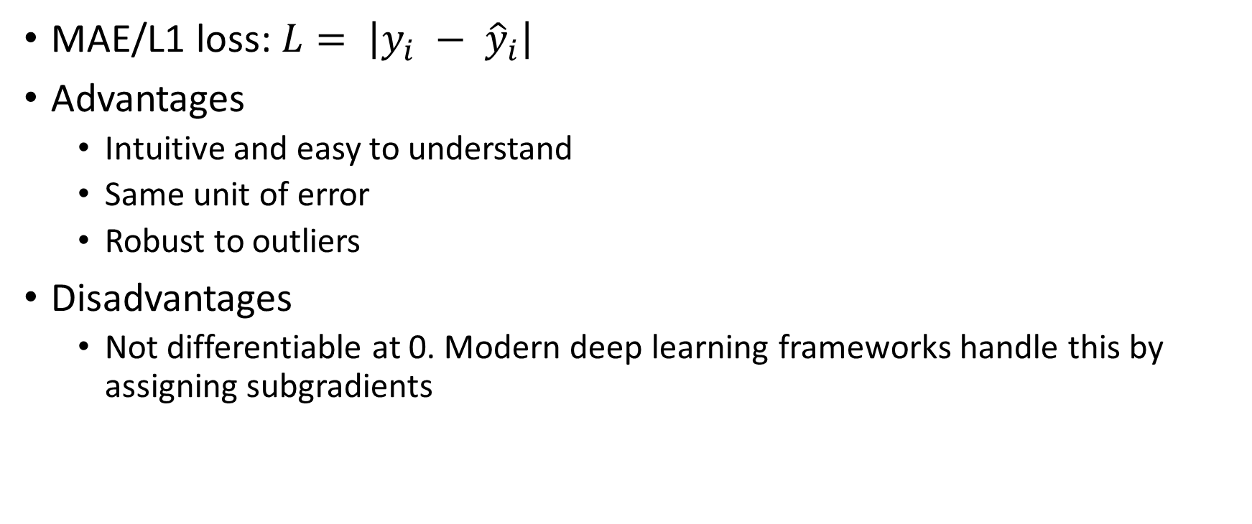
Regression loss functions
MAE/L1 loss: $L= \left|y_{i} − {\hat{y}}_{i}\right|$
Advantages
Intuitive and easy to understand
Same unit of error
Robust to outliers
Disadvantages
Not differentiable at 0. Modern deep learning frameworks handle this by assigning subgradients

Slide 6
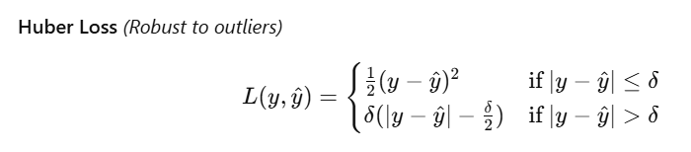
Regression loss functions

Slide 7
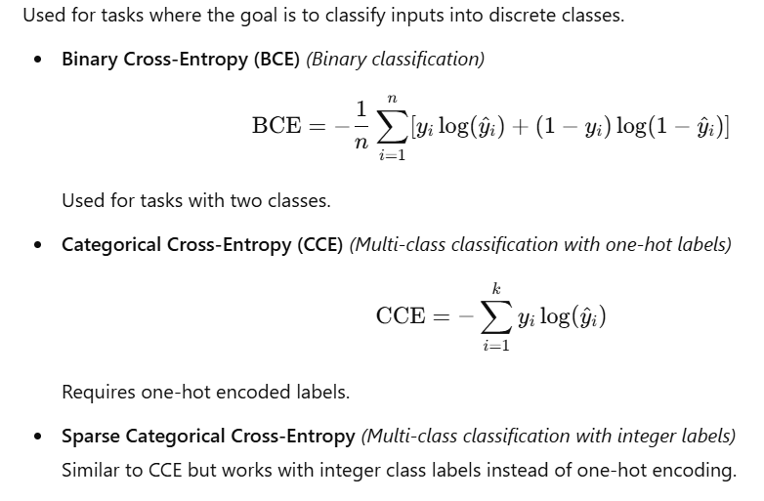
Classification Loss Function

Slide 8
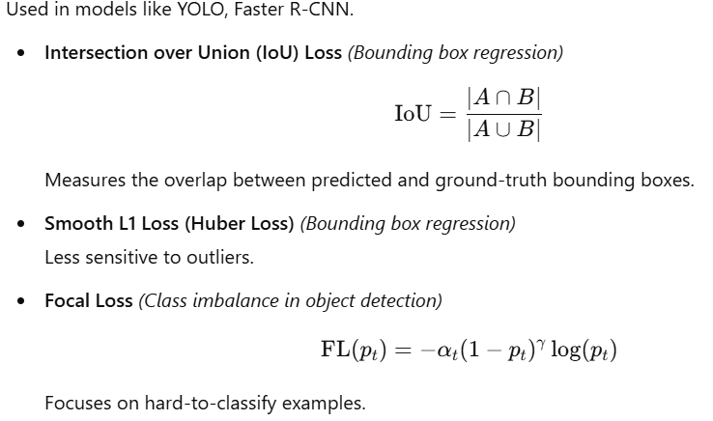
Object detection loss function

Slide 9
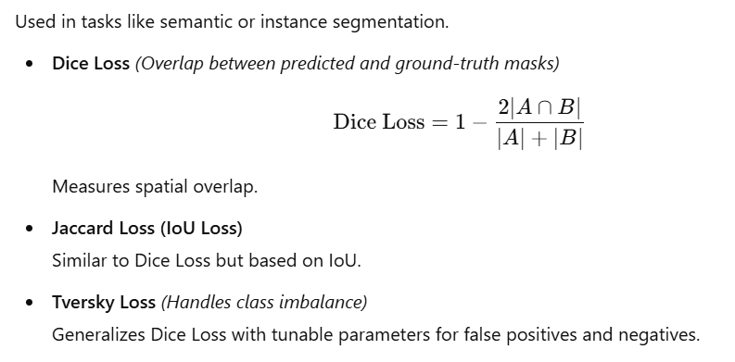
Image segmentation loss function

Slide 10
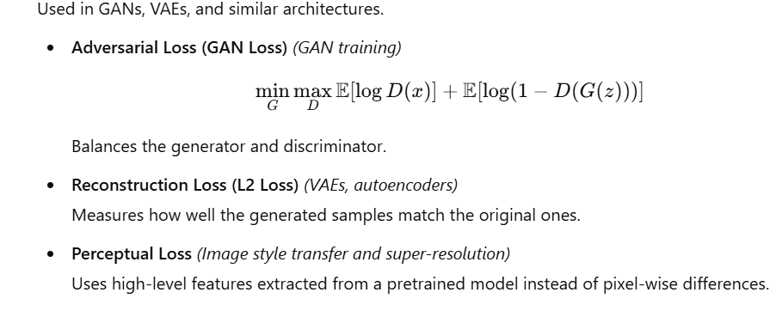
Generative model loss function

Slide 11
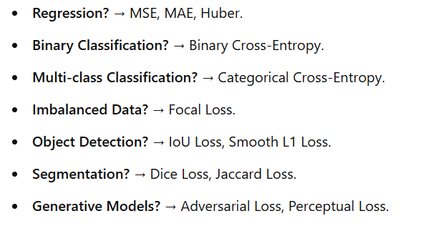
How to choose a loss function?

